Slide 1
Introduction to Marketing Analytics – A Refresher in Statistics
Dr Arne Floh
arne.floh@wu.ac.at

Slide 2
Overview
Introductory Example
Link to MARkETING THEORY
3 Take-Aways

Slide 3
Introductory Example

Slide 4

Tico Taco’s super taco option
Tico Taco, a chain of Mexican fast-food restaurants, headquartered in Wichita, Kansas, United States. The first Taco Tico was opened in 1962 and it offers tacos, fajitas, and burritos.
When it opened its 17th store in Wyoming, the management team considered to offer a super taco that would be two times as large as their regular taco and would contain 6 ounces of ground beef. The basic taco has spiced ground beef, lettuce, and cheese. Management felt that the super taco should offer more options.

Slide 5
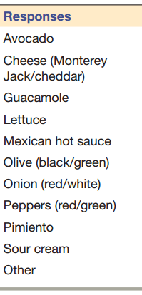
Why Marketing Analytics?
A marketing research study was undertaken to identify the target market and to determine what those other options should be.
1) Tico Taco predicted that this “Super Sonic Taco” would be popular among men under 30 who are not concerned about health issues, such as fat content or calories.
2) They recruited 500 men under 30, who are taco lovers, and asked them a question, ‘What, if anything, do you normally add to a taco that you have prepared at home besides meat?’
Consider the Tico Taco example.
  How to test the assumptions?
  How to determine the best options for this group?
  What are the differences between these two questions (statistics)?

Slide 6
Link to Marketing Theory

Slide 7
Two Types of Statistics
Descriptive Statistics
  Descriptive statistics are brief descriptive coefficients that summarize a given data set, which can be either a representation of the entire or a sample of a population.
  Descriptive statistics are broken down into measures of central tendency and measures of variability (spread). Measures of central tendency include the mean, median, and mode, while measures of variability include the standard deviation, variance, the minimum and maximum variables, and the kurtosis and skewness.
Inductive Statistics (Hypothesis Testing)
        Inductive statistics is the phase of statistics which is concerned with the conditions under which conclusions about populations can be drawn from analysis of particular samples.
        Inductive statistics is also known as statistical inference, or inferential statistics.

Slide 8
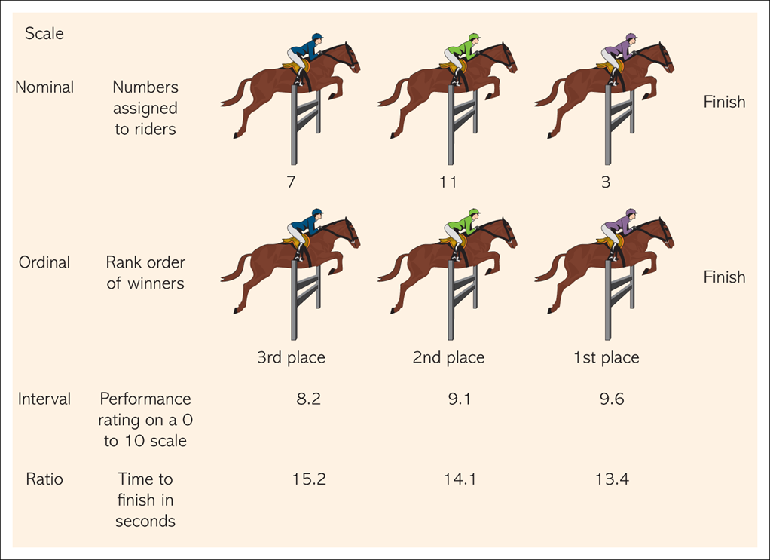
Illustration of Primary Scales

Slide 9
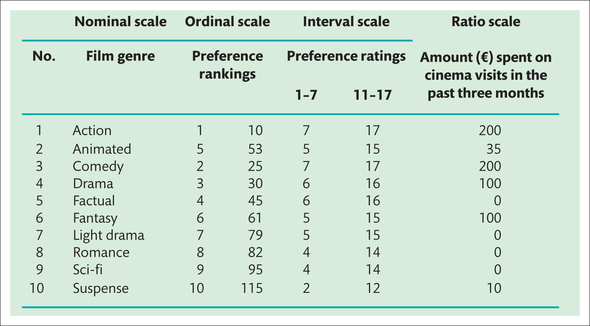
Illustration of Primary Scales II

Slide 10
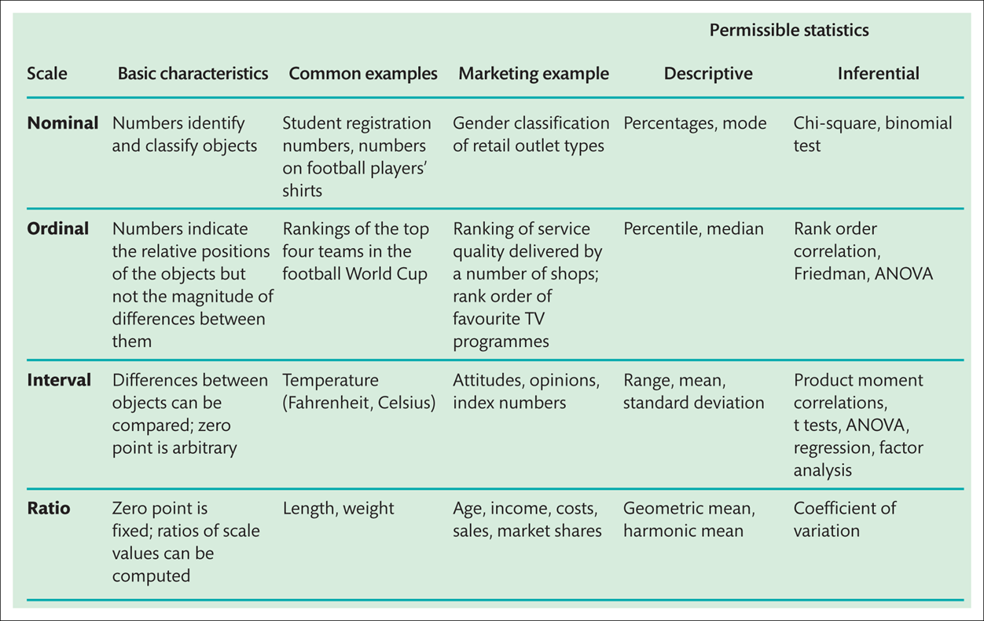
Primary Scales of Measurement

Slide 11
Descriptive Statistics

Slide 12
Central tendency: the mode
Mode
  - The most frequent score
Bimodal
  - Having two modes
Multimodal
  - Having several modes

Slide 13
Central tendency: the median
The Median is the middle score when scores are ordered:

Slide 14
Central tendency: the mean
Mean
  The sum of scores divided by the number of scores.
  Number of friends of 11 Facebook users.

Slide 15
The dispersion: range
The Range
  The smallest score subtracted from the largest
  For our Facebook friends data the highest score is 234 and the lowest is 22; therefore the range is: 234 −22 = 212

Slide 16
Deviance
We can calculate the spread of scores by looking at how different each score is from the center of a distribution e.g. the mean:

Slide 17
Sum of squared errors, SS
Indicates the total dispersion, or total deviance of scores from the mean:
It’s size is dependent on the number of scores in the data.
More useful to work with the average dispersion, known as the variance:

Slide 18
Standard deviation
The variance gives us a measure in units squared.
  In our Facebook example we would have to say that the average error in out data was 3224.6 friends squared.
This problem is solved by taking the square root of the variance, which is known as the standard deviation:

Slide 19
Same mean, different sd

Slide 20
The normal distribution

Slide 21
Probability density function of a normal distribution

Slide 22
Inductive Statistics

Slide 23
Why do we need Inductive Statistics?
Population – The aggregate of all the elements, sharing some common set of characteristics, that comprise the universe for the purpose of the marketing research problem.
Census – A complete enumeration of the elements of a population or study objects.
Sample – A subgroup of the elements of the population selected for participation in the study.

Slide 24
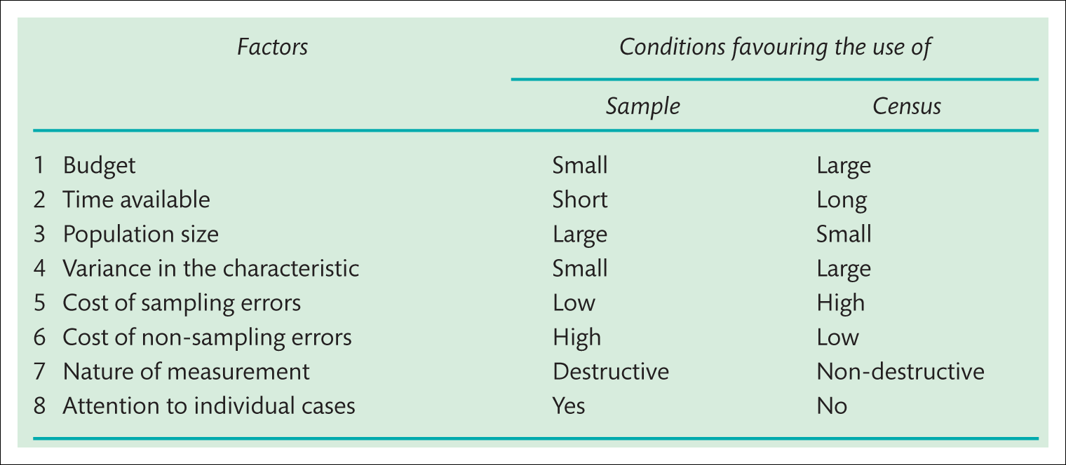
Why do we need Inductive Statistics?

Slide 25
Why do we need Inductive Statistics?
Assumption (hypothesis) made about a population parameter (not sample parameter)
Purpose of Hypothesis Testing
  To make a judgement about the difference between two sample statistics or between sample statistic and a hypothesized population parameter
Evidence has to be evaluated statistically before arriving at a conclusion regarding the hypothesis.
  Depends on whether information generated from the sample is with fewer or larger observations

Slide 26
What is a Hypothesis?
A hypothesis (plural: hypotheses), in a scientific context, is a testable statement about the relationship between two or more variables or a proposed explanation for some observed phenomenon.
In a scientific experiment or study, the hypothesis is a brief summation of the researcher's prediction of the study's findings, which may be supported or not by the outcome.
“If then” or “the higher ” sentences
Hypothesis of Association
  Customer satisfaction leads to customer loyalty.
Hypothesis of Difference
  Female and male customers differ in terms of their customer satisfaction

Slide 27
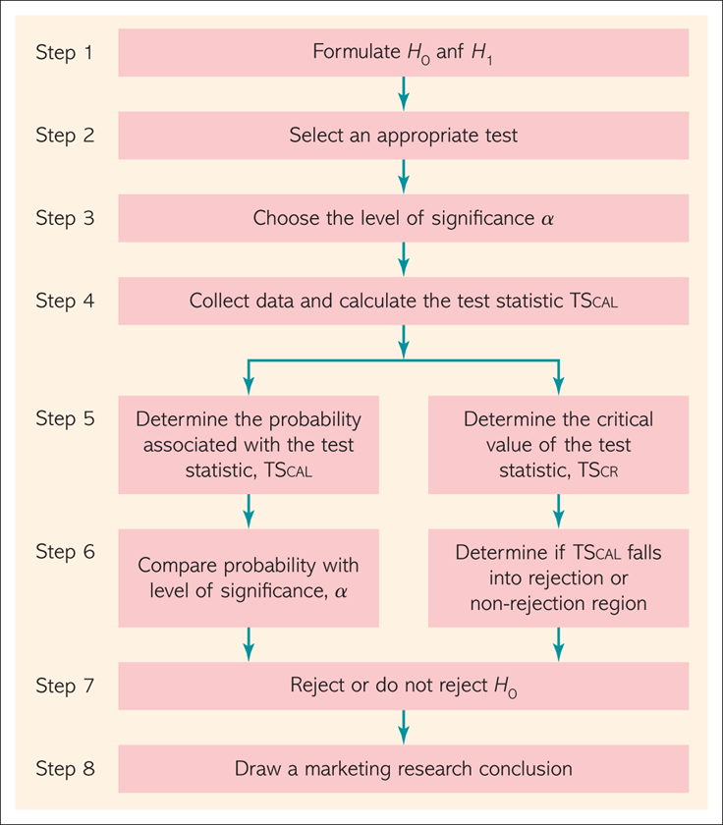
Process of Hypothesis Testing

Slide 28
Step 1: Formulating Hypotheses
A null hypothesis is a statement of the status quo, one of no difference or no effect. If the null hypothesis is not rejected, no changes will be made.
An alternative hypothesis is one in which some difference or effect is expected. Accepting the alternative hypothesis will lead to changes in opinions or actions.
The null hypothesis refers to a specified value of the population parameter, not a sample statistic.

Slide 29
Example
H₀: Female and male customers do NOT differ in terms of their customer satisfaction (in the population).
H_{A}: Female and male customers differ in terms of their customer satisfaction (in the population).
If H₀ is true, then Mean CS_{Male} = Mean CS_{Female}
If H_{A} is true, then Mean CS_{Male} <> Mean CS_{Female}

Slide 30
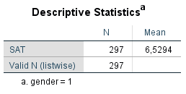

Example – Sample Means
Difference in Sample Means: 0.19
Sampling Error or True Effect in Population?

Slide 31
Step 2: Select an Appropriate Test
The test statistic measures how close the sample has come to the null hypothesis.
The test statistic often follows a well-known distribution, such as the normal, t, or chi-square distribution.
Independent Variable: Gender (nominal)
Dependent Variable: Customer Satisfaction (metric)
T-Test for Independent Samples
 | DV – nominal | DV - metric
IV – nominal | Chi-Square | T-Test, Anova
IV - metric | Logistic Regression | Correlation, Regression

Slide 32
Step 3: Choose the Level of Signficance
ACTUAL | PREDICTED
 |  | H₀ is predicted | H_{A} is predicted
 | H₀ is true | True negative | False positive (Type I or α error)
 | H_{A} is true | False negative (Type II or β error) | True positive

Slide 33
Step 3: Choose the Level of Signficance
Indicates the percentage of sample means that is outside the cut-off limits (critical value)
The higher the significance level (α) used for testing a hypothesis, the higher the probability of rejecting a null hypothesis when it is true (Type I error)
Accepting a null hypothesis when it is false is called a Type II error and its probability is (β)
When choosing a level of significance, there is an inherent tradeoff between these two types of errors
A good test of hypothesis should reject a null hypothesis when it is false

Slide 34
Step 3: Choose the Level of Significance
Type I error
  Type I error occurs when the sample results lead to the rejection of the null hypothesis when it is in fact true.
  The probability of type I error is also called the level of significance or alpha.
Type II error
  Type II error occurs when, based on the sample results, the null hypothesis is not rejected when it is in fact false.
  The probability of type II error is denoted by beta.
  Unlike alpha , which is specified by the researcher, the magnitude of depends on the actual value of the population parameter (proportion).

Slide 35
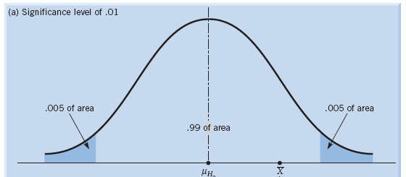
Step 3: Choose the Level of Significance
Convention in Marketing: alpha = 0.05 or 0.01

Slide 36
Step 4, 5 and 6: Calculate Test Statistic and Probability of Test Statistic
The level of statistical significance is often expressed as a p-value between 0 and 1. The smaller the p-value, the stronger the evidence that you should reject the null hypothesis.
A p-value less than 0.05 (typically ≤ 0.05) is statistically significant. It indicates strong evidence against the null hypothesis, as there is less than a 5% probability the null is correct (and the results are random). Therefore, we reject the null hypothesis, and accept the alternative hypothesis.
A p-value higher than 0.05 (> 0.05) is not statistically significant and indicates weak evidence against the null hypothesis. This means we fail to reject the null hypothesis and cannot accept the alternative hypothesis.

Slide 37
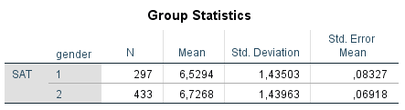
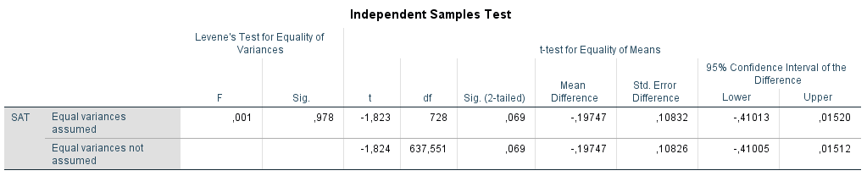
Step 4, 5 and 6: Calculate Test Statistic and Probability of Test Statistic
p (0.069) > .05 → H₀ accepted

Slide 38
Take-Aways

Slide 39
Take-Aways
Descriptive statistics are efficient ways of summarizing the basic characteristics of large sets of data. In a statistical analysis, the analyst calculates one or a few numbers that reveal something about the characteristics of large sets of data.
Inductive statistics takes data from a sample and makes inferences about the larger population from which the sample was drawn. In an inductive analysis, the analyst need to have confidence that the sample accurately reflects the population.
Several main steps are involved in testing a hypothesis: 1) specify the hypothesis; 2) select an appropriate statistical technique to test the hypothesis; 3) specify a decision rule to determine whether to reject or fail to reject the null hypothesis; 4) calculate the value of the test statistic and perform the test; 5) the conclusion is stated from the perspective of the original research problem or question

Slide 40
Thank you!
Any questions?

